Slide 1

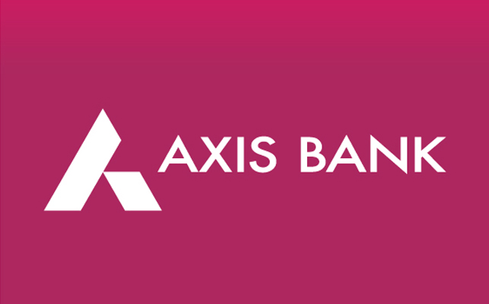
Digital Marketing Project Presentation
Topic: Axis Bank
Name of the university: Dravidian University
Name of The Guide: Mrs.A.Deepika
Names of the Student:
Y.Siva Raju (group Leader)
1.V.Naveen
2. V.Nagendhra Babu
3. V. Veni
4. Y. Sripadma
5.A. Kalyani

Slide 2
Research Brand: Axis Bank
Part-1: Brand Study, Competitor Analysis & Buyer’s / Audience Persona:
Missions/Values of the brand:
Axis Bank's mission is to be the preferred financial solutions provider excelling in customer delivery through insight, empowered employees and smart use of technology.
Core Values
Customer Centricity.
Ethics.
Transparency.
Teamwork.
Ownership.
Smart Goals Of Axis Bank:
Bajaj Allianz Life Smart Wealth Goal is designed to offer a solution to all the financial needs of the whole family with its three variants:
1. Wealth
2. Joint Life Wealth
3.Child Wealth.

Slide 3
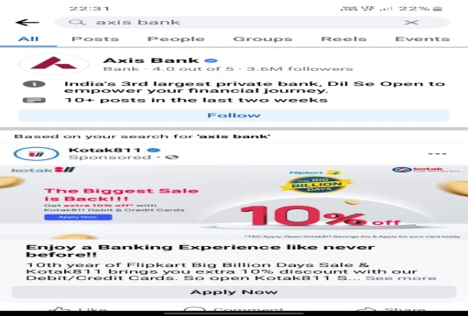
KPIs of Axis Bank
There are more than 247K followers in Instagram Social Media.
Pink is a dominant colour used in Instagram.
There is a 3.6m followers in Facebook which shows their competetion level in the social madia platform.
Here also pink is a dominant colour used to represent the colour.
Buyer’s /Audience Persona:
Axis Bank is the third largest private sector bank in India offering the entire spectrum of financial services to customer segments covering Large and Mid-Corporates, MSME, Agriculture and Retail Businesses
Primary cardholder between the age of 18 years and 70 years
There are more than one billion Indians are using Axis Bank.
As a customer anyone need offers on their cards to encourage online shopping.
By considering demographics the percentage of using Axis bank has been Increased.
Based on some social media’s the customers are enjoying by using Axis bank updates and features.

Slide 4
Competitor Analysis: Analysing of competitors of Axis Bank through SWOT Analysis.
Competitor name | Strength | Weakness | Oppurtunities | Threats | Rank of the bank
ICICI bank | It have 5,900 branches across 17 countries | Customer disputes against ICICI are high. | projected to rise at a rate of 17 percent.In the next three years, Banking Sector growth is | RBI allowed foreign banks to invest in Indian banking up to 74 percent. | 2
IDBI ltd. | 1892 branches, one of which is in Dubai abroad | Rural market is less penetrated by Urban market | IDBI is part of the public sector the potential for implementation of government schemes is strong. | To retain loyal customers, the Bank must focus on improving customer satisfaction | 9
HDFC bank | The bank has up to 6,342 branches and 18,130 ATMs | lack of rural dominance | banking credit is expected to have double-digit growth in the next few years. | Government banks have started becoming more flexible, which makes them more competitive with private banks | 3

Slide 5
SWOT analysis of Axis Bank
Part-2:SEO and Keyword Analysis
Strength:
Axis Bank was ranked is the fastest growing Bank in the Private Sector. Financial Express and KPMG have rated Axis Bank as the best bank on the basis of 26 parameters.
Axis Bank has 4800 regional branches and 17801 ATMs.
Weakness:
Gaps – primarily focused on corporate banking, wholesale banking, treasury services, retail banking.
Global branches account for just 8 % of the total assets. The bank has recently begun to concentrate its attention on personal banking and rural areas.
Opportunities:
The internet banking network can be supported.
UPI payments and mobile wallets can be promoted.
Threats:
RBI control of interest rates.
Regulation of the State on the basis of pandemic circumstances.

Slide 6
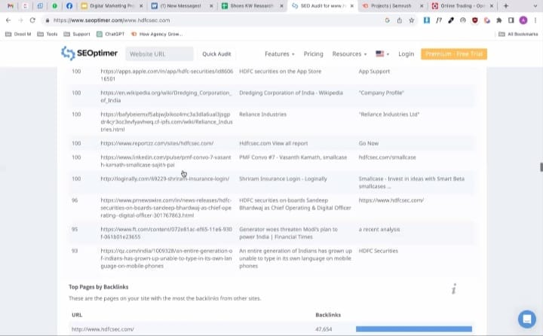
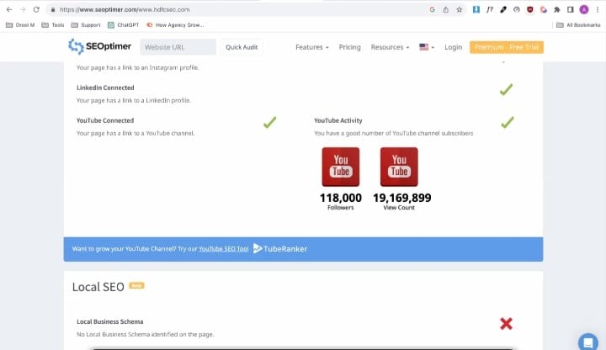
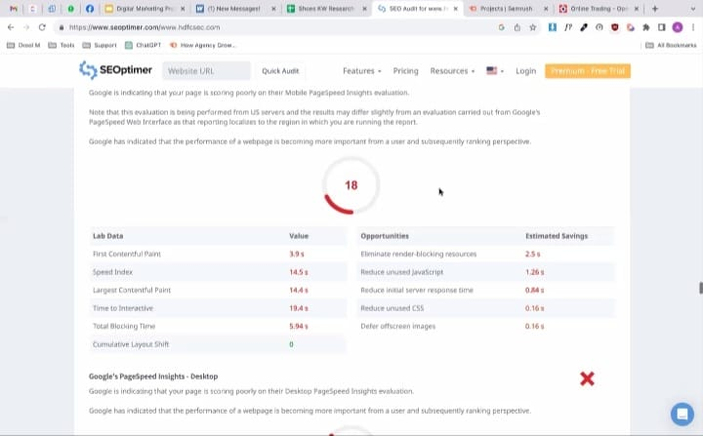
SEO Research:

Slide 7
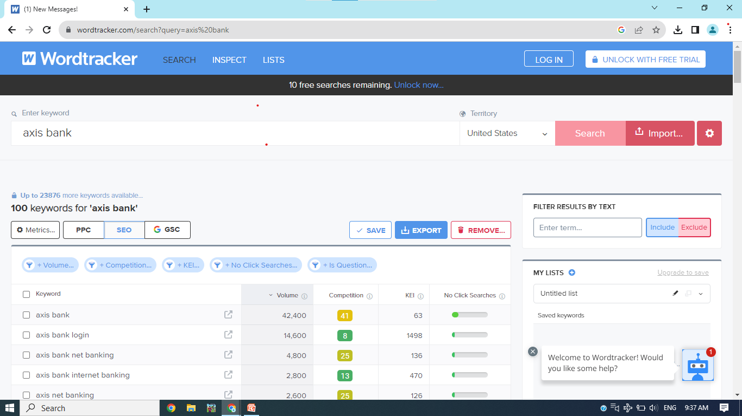
SEO Research:
Key word Research:
Brainstorm seed keywords:

Slide 9
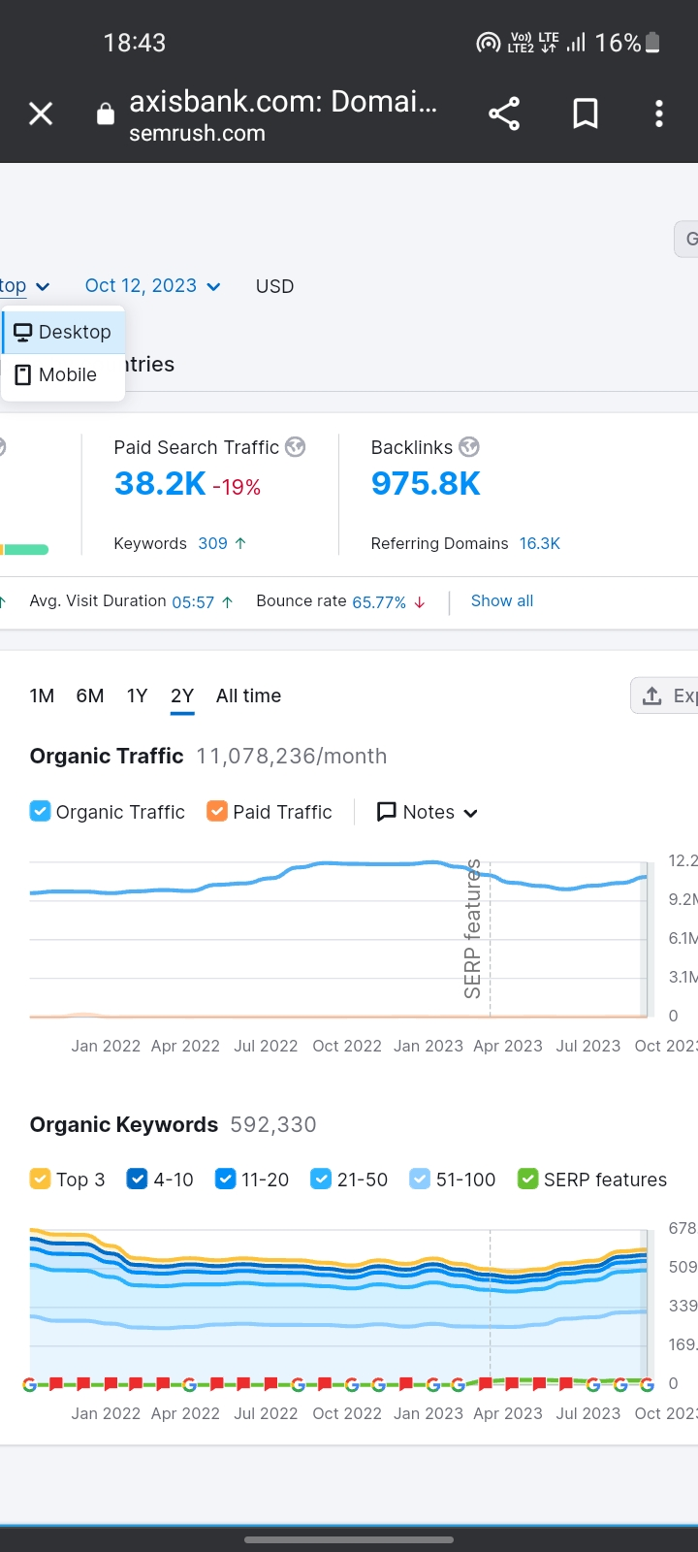
Domain Overview of Axis bank

Slide 10
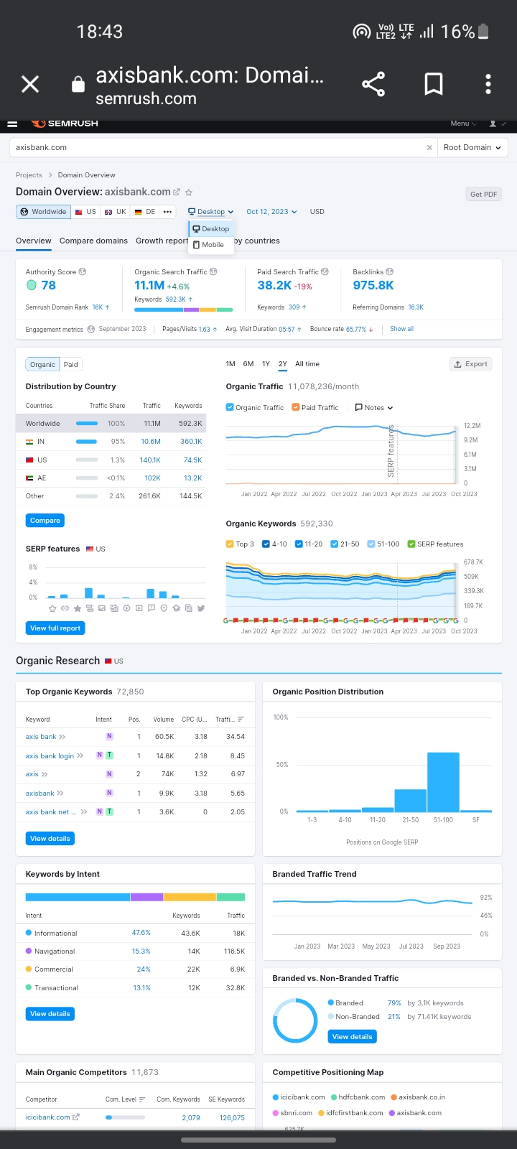

Slide 11
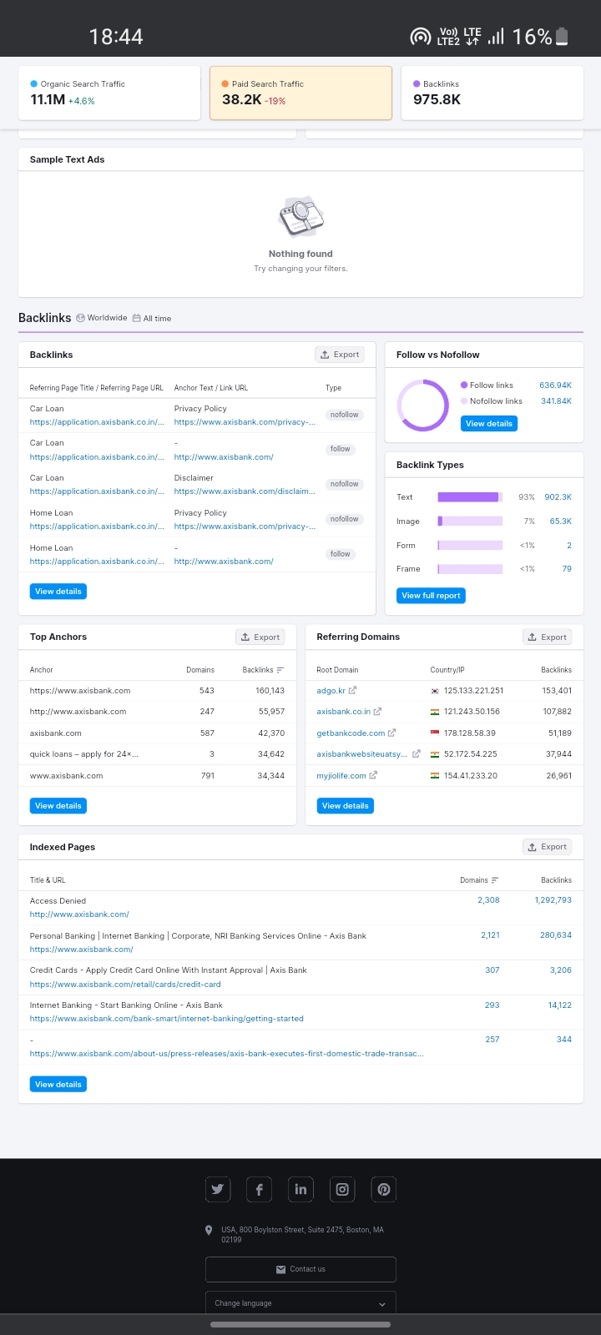

Slide 12
On Page Optimization:
Sl .No. | Key Word | Avg. Monthly Purchases
1 | Axis bank login | 14,600
2 | Axis bank net banking | 4800
3 | Axis bank internet banking | 2800
Meta title:
Axis bank Net banking and Internet banking Login/
Meta Description:
Open Axis bank login and net or internet bank in different devices like mobile,laptop,tab,computer etc….
We are providing a online platform for effective work and to save time.

Slide 13
Part-3:Content Ideas and Marketing Strategies
October Month | Post/Story Links | Social media platform
Oct1 | https://m.facebook.com/story.php?story_fbid=pfbid02wdXgp2YPMJfVaR3WruL3kAMMBNXvaw3QQFcFj6cThJW7989dQoAGE9f9PiM3fiyQl&id=100064334155430&mibextid=CDWPTG | Facebook
oct2 | https://fb.watch/nEGBAbpjfO/?mibextid=ZbWKwL | Facebook
oct3 | https://fb.watch/nEGApeDWOH/?mibextid=ZbWKwL | Facebook
Oct4 | https://www.instagram.com/p/Cxp9ECQPGLS/?igshid=MWZjMTM2ODFkZg== | Instagram
Oct5 | https://instagram.com/stories/shivaraju143143/3212072599031348827?igshid=NmQ4MjZlMjE5YQ== | Instagram
Oct6 | https://instagram.com/stories/shivaraju143143/3212078365620387630?igshid=NmQ4MjZlMjE5YQ== | Instagram
Oct7 | https://m.facebook.com/story.php?story_fbid=pfbid02wdXgp2YPMJfVaR3WruL3kAMMBNXvaw3QQFcFj6cThJW7989dQoAGE9f9PiM3fiyQl&id=100064334155430&mibextid=CDWPTG | Facebook

Slide 14
The main aim/strategy behind the story/post is to sustain in social media platform.
Aim & Strategy Behind The Stories & Post
To increase net banking and Internet banking
To create more goodwill over the bank cards and offers
Marketing Strategies and Content Ideas:
Axis bank is promoting its offers and products aggressively through different channels. These include print advertisements, TVC, and digital marketing channels. Axis Bank also gives discounts and offers to its customers on interest rates and gift hampers in lucky draws for those who take loans.

Slide 15
Part-4: Content Creation & Curation
Post Creation:
1.https://m.facebook.com/story.php?story_fbid=pfbid02wdXgp2YPMJfVaR3WruL3kAMMBNXvaw3QQFcFj6cThJW7989dQoAGE9f9PiM3fiyQl&id=100064334155430&mibextid=CDWPTG
2.https://m.facebook.com/story.php?story_fbid=pfbid02wdXgp2YPMJfVaR3WruL3kAMMBNXvaw3QQFcFj6cThJW7989dQoAGE9f9PiM3fiyQl&id=100064334155430&mibextid=CDWPTG
Brainstorm About Trending Topics Of Axis Bank
6 steps to get a home loan
6 steps to look up before you pray for home loan
Axis Bank
5 benefits of getting personal loan EMI
Good reasons to invest on Property during festival Time

Slide 16
Brainstorm Ideas for Axis bank
Chairman
Sanjiv Misra
Found 1993
3rd Largest private sector
Axis Bank
MD & CEO
Shika Sharma
Tagline badhti ka namm zindagi
Brand Ambassador
Deepika padukone

Slide 17
Instagram Story
Story Links:
Day1:
https://instagram.com/stories/shivaraju143143/3212072599031348827?igshid=NmQ4MjZlMjE5YQ==
Day2:
https://instagram.com/stories/shivaraju143143/3212078365620387630?igshid=NmQ4MjZlMjE5YQ==
Day3:
https://instagram.com/stories/shivaraju143143/3212079237322512952?igshid=NmQ4MjZlMjE5YQ==

Slide 18
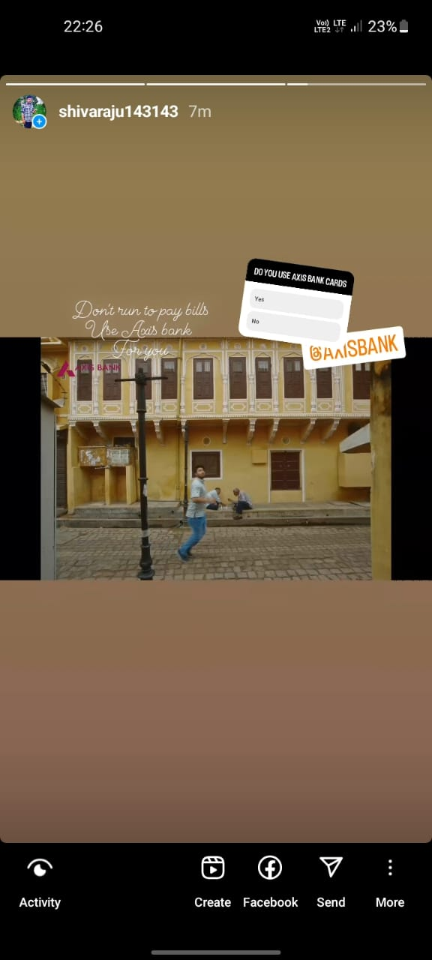
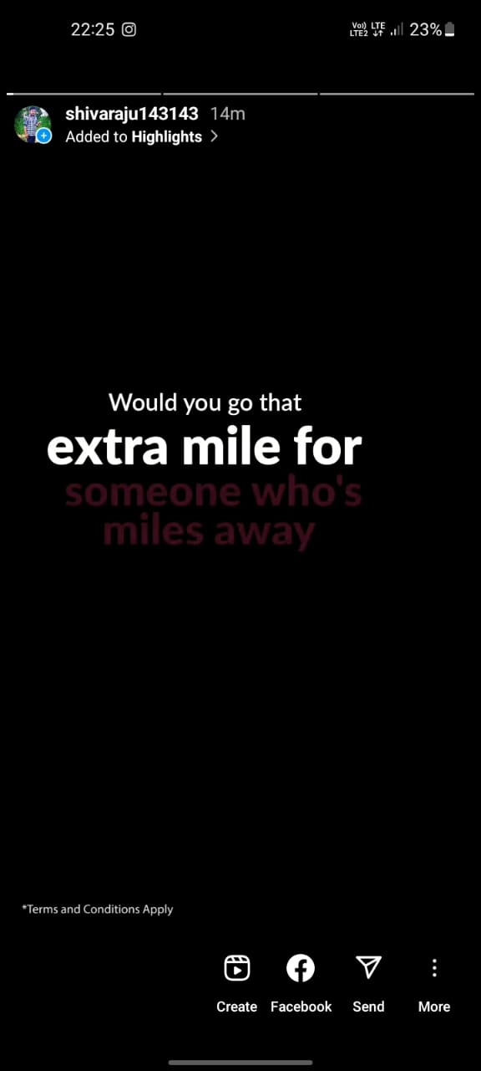
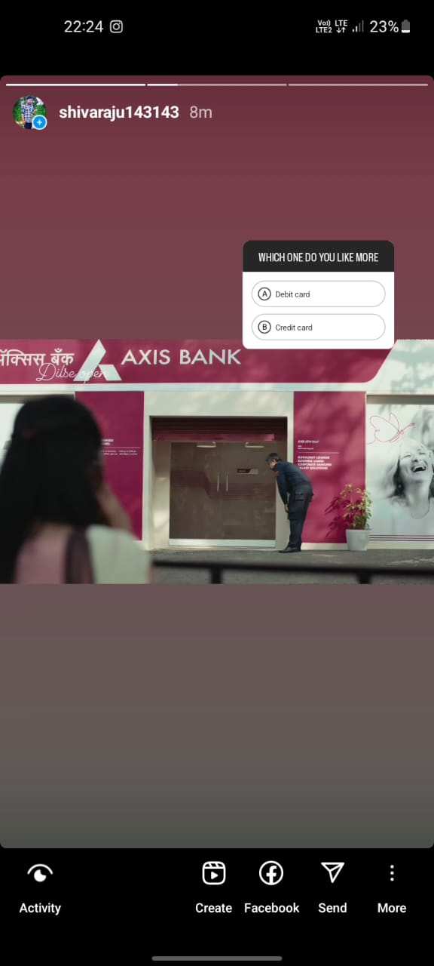
Story Screenshots:

Slide 19
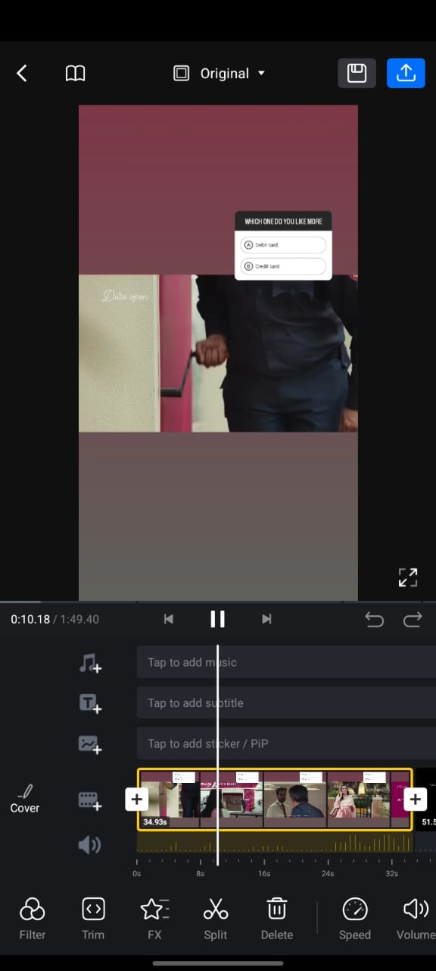
Design Or Video Editing
Editing a video relating to axis bank by Using VN application.

